Slide 1
Types of variables based on their scope
Global variable: the variable that is defined outside of the main function.
Local variable: is the variable that is defined between the brace of function, inside of function, loops, control statement. The scope of these variables is limit inside the field that is defined in.

Slide 2
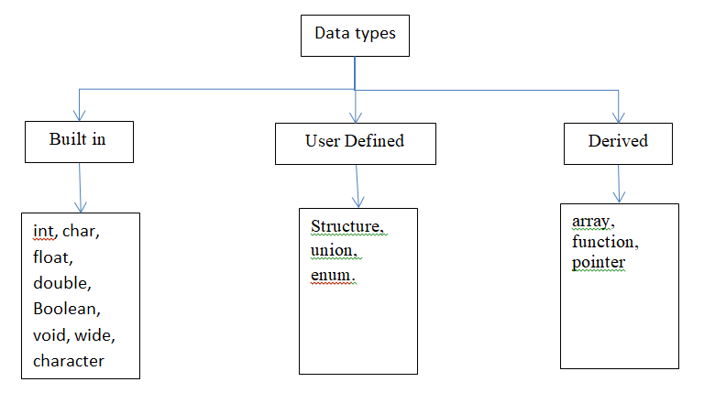
Data types in C++

Slide 3
Built in data type
char: For characters. Size 1 byte,
char ch = ‘A’;
int: For integers. Size 2 bytes.
int num = 100;
float: For single precision floating point. Size 4 bytes.
float num = 123.78987;
double: For double precision floating point. Size 8 bytes.
double num = 10098.98899;
bool: For booleans, true or false.
bool b = true;

